Slide 1
Base Erosion and Profit Shifting and Good Tax Governance
AOTCA 23. – 24. October 2014
Jiri Nekovar
Notes:
1

Slide 2
Causes
Countries‘ tax sovereignty
Lack of Cooperation
Lack of Transparency
Notes:
2

Slide 3
“Exploitation“ of mismatches
Gaps & loopholes
Base Erosion & Profit Shifting
Aggressive Tax Planning
Notes:
3

Slide 4
Effects
Double Taxation
&
Double Non- Taxation

Slide 5
Transparency
Fair Competition
Good Governance
Information Exchange
Economic Substance

Slide 6
Globalization
Corporate Governance
Competitiveness
Taxation

Slide 7
Arm‘s length principle
Economic substance
Transfer Pricing
Functional analysis
Comparability analysis

Slide 8
“The very low effective tax rates that multinationals can achieve through international tax planning continue to raise serious concerns. Leaders, civil society and everyday taxpayers have renewed demands for greater transparency and action to tackle offshore tax evasion as well as changes to the international tax rules to restore fairness and integrity of their tax systems and the global financial system more generally“ (OECD Secretary – general report to the G20 leaders, St. Petersburg, February 2013)

Slide 9
Integrity of tax systems
Restore trust in Countries‘ tax systems
Ensure tax compliance
Improve fairness
Set the standards and providing the instruments to fight tax evasion
OECD‘s work on Base Erosion and Profit Shifting (BEPS)
Development by the OECD and the G20 countries of a Global Model for Automatic Exchange of Information
Global Forum on Transparency and Exchange of Information for Tax Purposes

Slide 10
Transparency
Fair Tax Competition
Exchange of information

Slide 11
What does the acronym BEPS* strategically mean?
BEPS project:
Single set of consensus-based international tax rules (i.e. new international framework for allocating taxable profits and income across Countries) in view of a newly internationally conceived Profit Sharing mechanisms
*’’refers to tax planning strategies that exploit gaps and mismatches in tax rules to make profits disappear for tax purposes or to shift profits to locations where there is little or no real activity but the taxes are low, resulting in little or no overall corporate tax being paid.“

Slide 12
BEPS goals:
Realignment of taxation with
economic activities
value creation processes
Protection of the tax bases with
increased certainty
predictability

Slide 13
BEPS numbers:
44 countries on an equal footing (all OECD countries, G20 and others)
7 deliverables issued
3.500 pages of comments
5 public consultations
3 webcasts with 10.000 viewers

Slide 14
BEPS deliverables
ensure the coherence of corporate income taxation at the international level, through new model tax and treaty provisions to neutralise hybrid mismatch arrangements (Action 2)
realign taxation and relevant substance to restore the intended benefits of international standards and to prevent the abuse of tax treaties (Action 6)
assure that transfer pricing outcomes are in line with value creation, through actions to address transfer pricing issues in the key area of intangibles (Action 8)

Slide 15
improve transparency for tax administrations and increase certainty and predictability for taxpayers through improved transfer pricing documentation and a template for country-by-country reporting (Action 13)
address the challenges of the digital economy (Action 1)
facilitate swift implementation of the BEPS actions through a report on the feasibility of developing a multilateral instrument to amend bilateral tax treaties (Action 15)
counter harmful tax practices (Action 5)

Slide 16
BEPS outcome:
Hybrid mismatches will be neutralised,
Treaty shopping and other forms of treaty abuse will be addressed,
Abuse of transfer pricing rules (intangibles) will be minimised,
C-b-C reporting will provide key info to Tax Authorities

Slide 17
OECD Action Plan on BEPS: 15 Key Actions
Action 1 – Address the Tax Challenges of the Digital Economy
Action 2 – Neutralise the Effects of Hybrid Mismatch Arrangements
Action 3 – Strenghten CFC Rules
Action 4 – Limit Base Erosion via Interest Deductions and Other Financial Payments
Action 5 – Counter Harmful Tax Practices More Effectively, Taking into Account Transparency and Substance

Slide 18
Action 6 – Prevent Treaty Abuse
Action 7 – Prevent the Artificial Avoidance of PE Status
Action 8 – Assure that Transfer Pricing Outcomes are in Line With Value Creation/ Intangibles
Action 9 – Assure that Transfer Pricing Outcomes are in Line With Value Creation/ Risks and Capital
Action 10 – Assure that Transfer Pricing Outcomes are in Line With Value Creation/ Other High-Risk Transactions

Slide 19
Action 11 – Establish Methodologies to Collect and Analyze Data on BEPS and the Actions to Address It
Action 12 – Require Taxpayers to Disclose Their Aggressive Tax Planning Arrangements
Action 13 –
Re-examine Transfer Pricing Documentation
Action 14 – Make Dispute Resolution Mechanisms More Effective
Action 15 – Develop a Multilateral Instrument

Slide 20
Publication of Discussion Drafts
TP Aspects of Intangibles (Action 8) – 30 July 2013
TPD & Country by Country Reporting (Action 13) – 30 January 2014
Tax Treaty Abuse (Action 6) – 14 March 2014
Hybrid Mismatch Arrangements (Action 2) – 19 March 2014
Tax Challenges of the Digital Economy (Action 1) – 24 March 2014
Methodologies to collect/ analyse date (Action 11) – 4 August 2014

Slide 21
September 2014
Digital Economy Report
Recommendations on hybrid mismatch arrangements
Review of Member country regimes to counter harmful tax practices more effectively
Recommendations to prevent abuse of tax treaties
TP rules in relation to intangibles
TP documentation and country-by-country reporting template
Multilateral instrument Report
Published on September 16, 2014

Slide 22
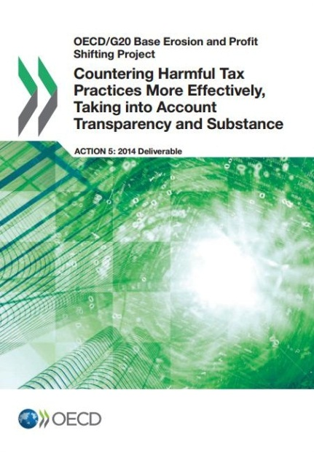
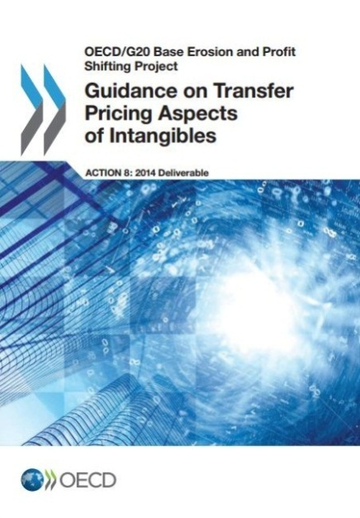
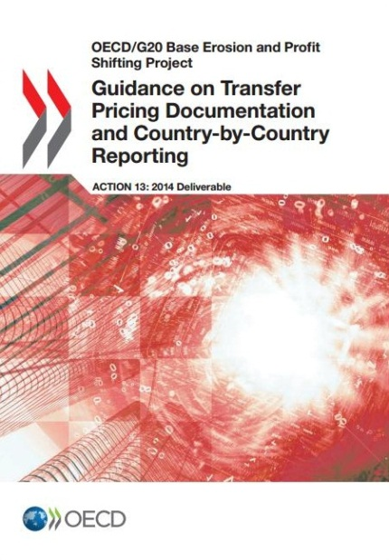
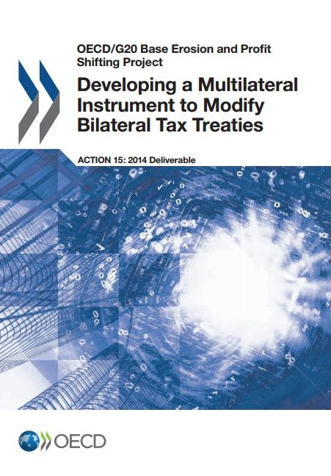
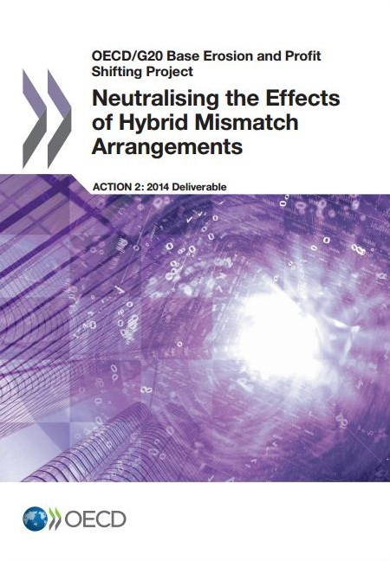
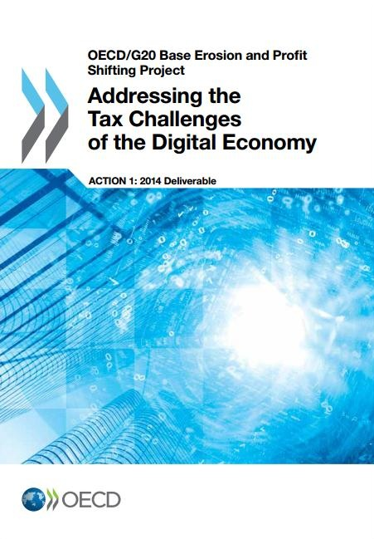

Slide 23
September 2015
CFC rules
Limiting base erosion via interest deductions and other financial payments
Expand participation in the Forum on Harmful Tax Practices to non-OECD Members
Tax treaty measures to prevent the artificial avoidance of PE status
TP rules in relation to intangibles, risks and capital, and other high-risk transactions
Report on data collection
Make dispute resolution mechanisms more effective

Slide 24
December 2015
Changes to the TP rules to limit base erosion via interest deductions and other financial payments
Revision of existing criteria to counter harmful tax practices more effectively
Development of a Multilateral instrument

Slide 25
Thank you for your attention!

