Slide 1
TAXPAYER CHARTER PROJECT
Presented By:
Michael Cadesky
David Russell
for AOTCA 2014 Conference

Slide 2
Taxpayer Charter Project
Origins of the Project
Collaboration of Organizations
Study Methodology
Model Charter
Preliminary Report
What Comes Next
End Goals

Slide 3
Origins of the Project
Increased compliance burden
Increased complexity of legislation
Increased uncertainty in tax matters
Taxpayer Responsibilities:

Slide 4
Taxpayer Rights
Increasingly limited
Little progress
No agreed on standard across the world
No unified voice
No legal force

Slide 5
Collaboration of Organizations
CFE – Europe AOTCA – Asia Pacific STEP – Worldwide
500,000 tax advisors
50 countries
73% of world GDP

Slide 6
WORLDWIDE COVERAGE
STEP | 20,000
CFE | 180,000
AOTCA | 330,000
Total Membership: over 500,000 worldwide (combined)

Slide 7
OVERLAP OF INTERESTS
CFE
AOTCA
STEP
STEP overlaps with AOTCA/CFE in private client areas.

Slide 8
Committee of 9 people CFE/AOTCA/STEP
Authors – 3 persons CFE/AOTCA/STEP
CFE – Ian Hayes AOTCA – David Russell STEP – Michael Cadesky
Website
Support staff – research – editorial

Slide 9
Study Methodology
Library of Research Materials
Compiled Extensive Survey
37 Countries Responded
164 Questions
Over 6,000 Answers

Slide 10
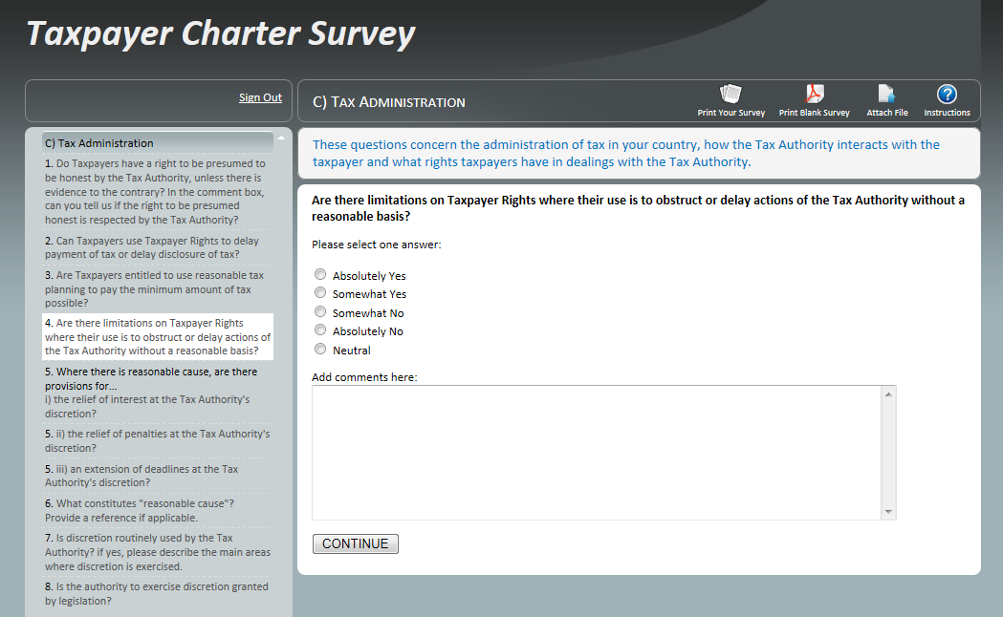
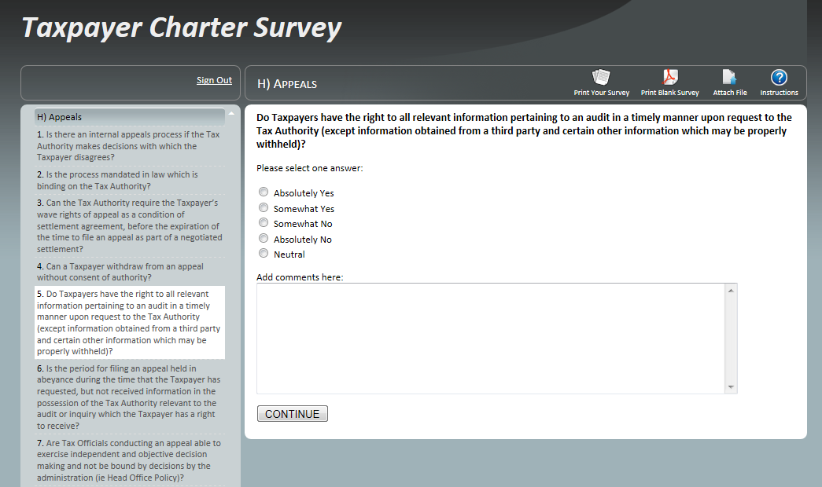

Slide 11
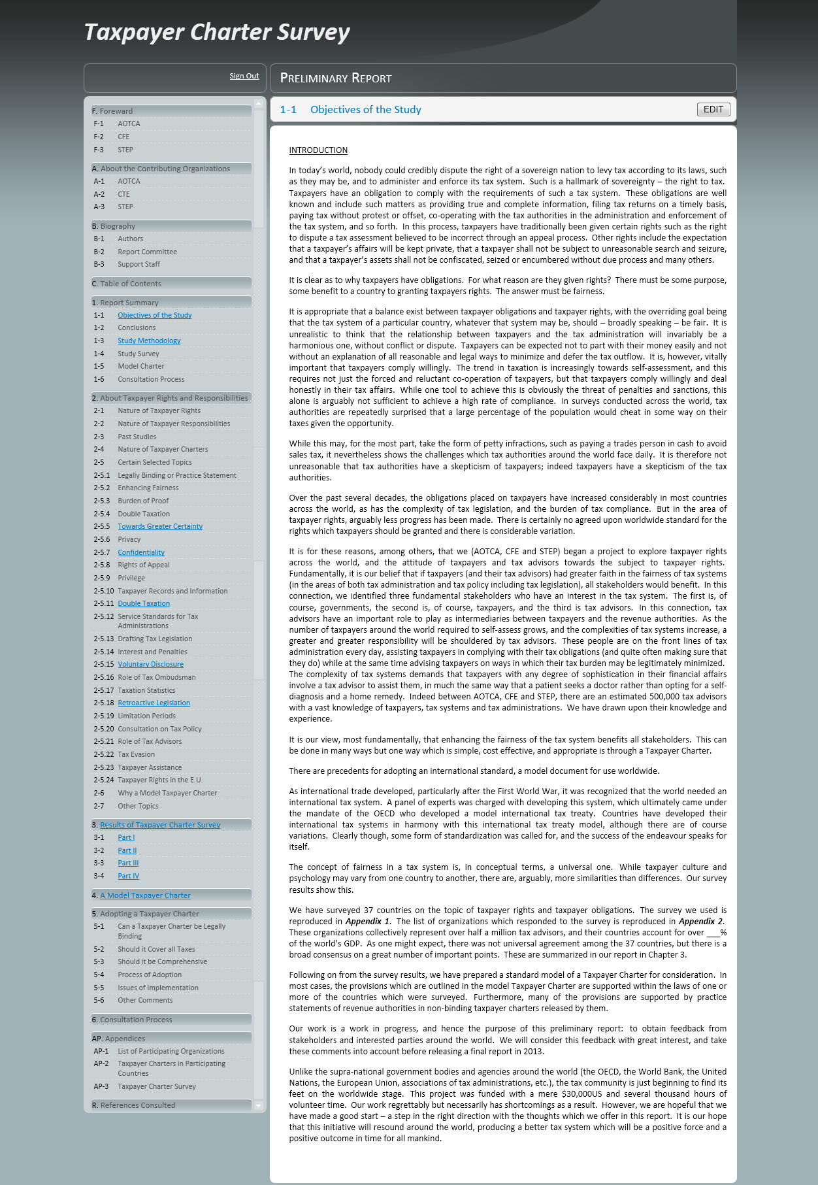

Slide 12
Model Charter Developed
Refined by Survey Results
Test of Validity (Charter ⬅➔ Survey)

Slide 13
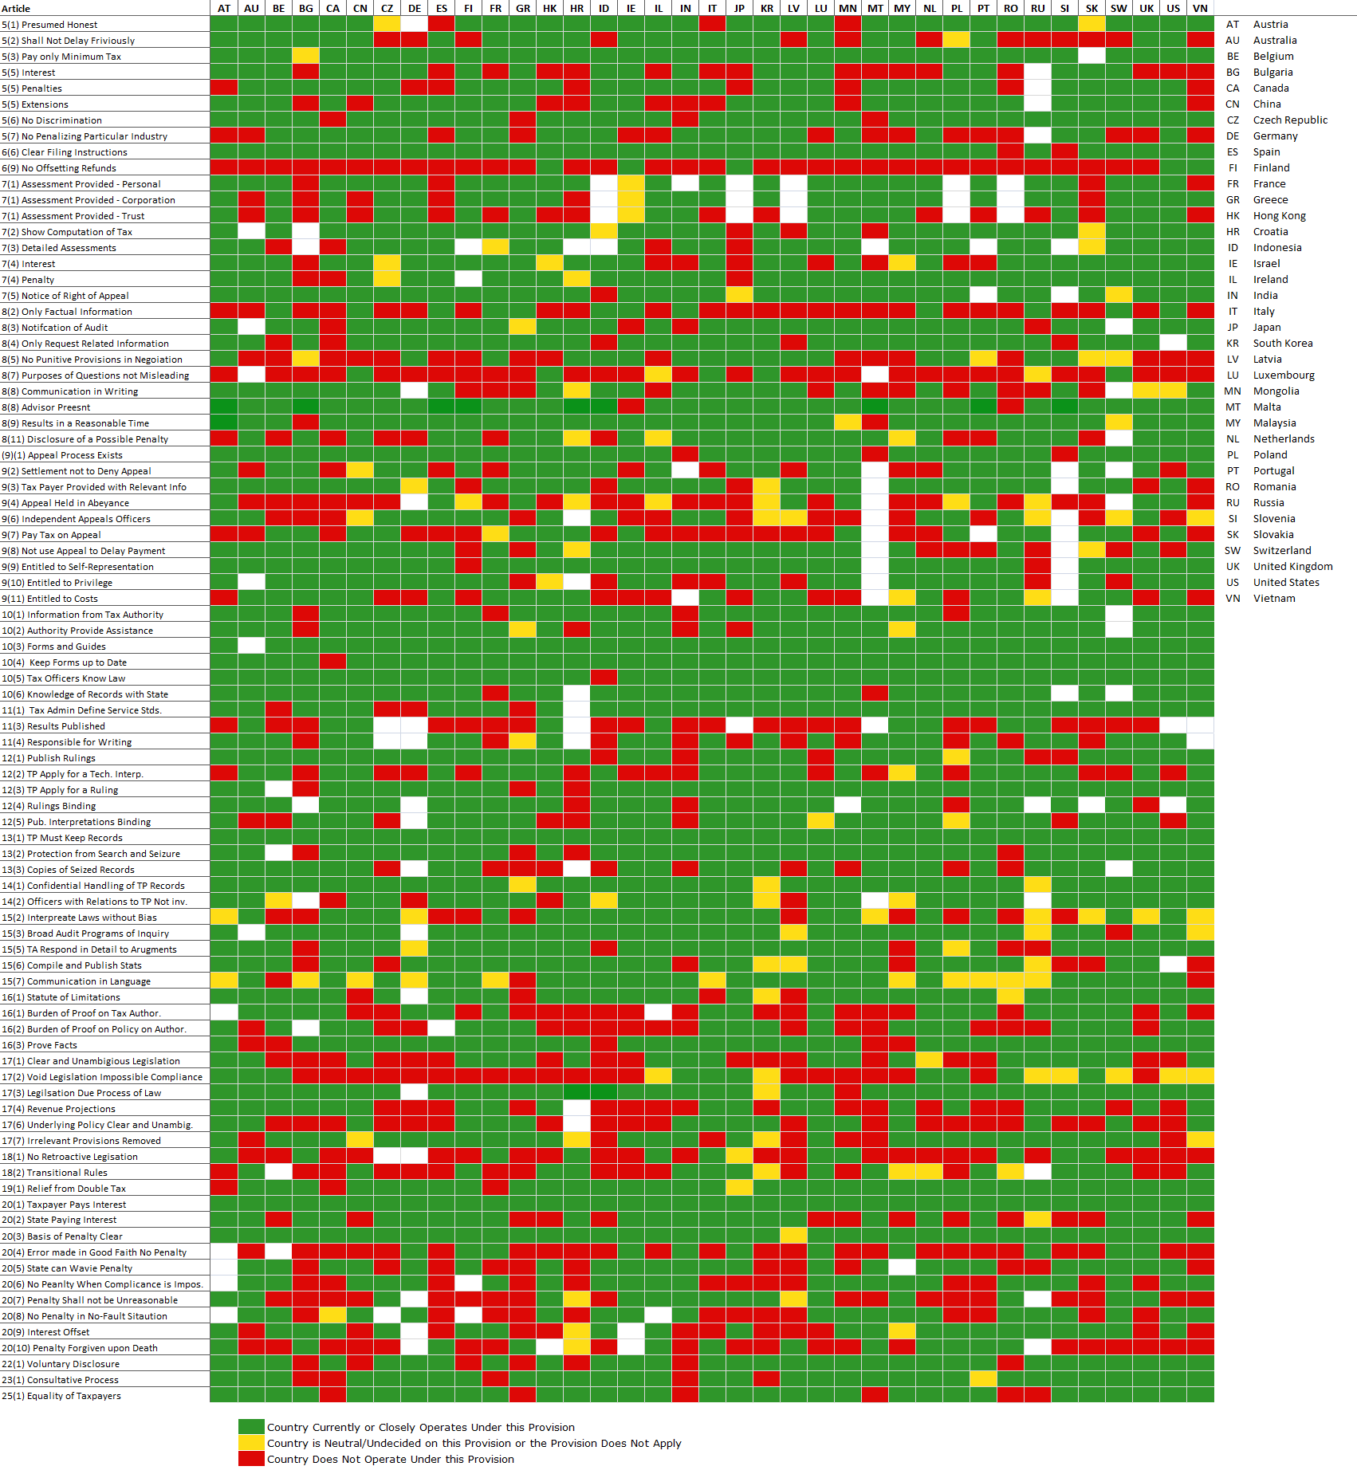

Slide 14
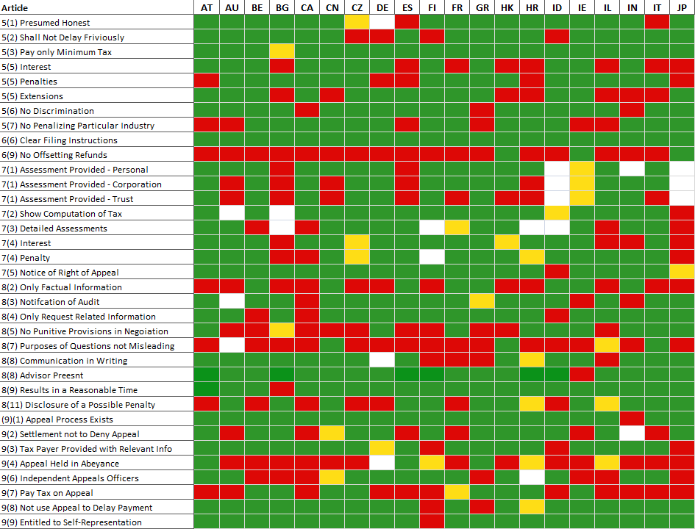

Slide 15
Preliminary Report
Length – 200 pages
Form – soft cover book
Distribution – Finance and Revenue Ministers, Commissioners, Deputies in 37 countries – OECD – E.U. Parliament – United Nations – IMF – World Bank – AOTCA/CFE/STEP – Media

Slide 16
Visits
E.U. Parliamentary Committee on Taxpayer Code
OECD (Pascal Saint-Amans)
UN (Committee of Experts on International Cooperation in Tax Matters)

Slide 17
Feedback
OECD Letter - should be principles based
- tax advisors should have more responsibilities
- should consider enhance relationship
- uses old fashioned confrontational approach to tax administration
Certain Countries - U.K.
- Indonesia

Slide 18
Next Steps
Final Report
Guiding Principles at the Beginning
Expanded Provisions on Tax Advisors
But otherwise will be similar
Early 2015

Slide 19
End Goals
Adoption as worldwide standard
Project to give Tax Profession a Worldwide voice
Improve Relationships between Taxpayers, Tax advisors and Tax Administrations

