Slide 1
Evolution of Singapore’s Anti-avoidance Tax Provision
Mrs Chung-Sim Siew Moon
Board Member, Singapore Institute of Accredited Tax Professionals
Asia-Pacific Tax Policy and Controversy Leader & Partner, Ernst & Young Solutions LLP
Singapore
Ulaanbaatar, Mongolia, 2018

Slide 2
Outline
Singapore’s anti-avoidance tax provision [Section 33 of the Singapore Income Tax Act (SITA)]
Before 1988 Amendment
Amendment in 1988
Landmark anti-avoidance tax case, Comptroller of Income Tax (CIT) v AQQ and another appeal [2014] SGCA 15
The approach to Section 33
Latest anti-avoidance tax case, GBF v CIT [2016] SGITBR 1
01
Promoting Tax Excellence
© 2018 Singapore Institute of Accredited Tax Professionals

Slide 3
Section 33
Prior to 29 January 1988 (Before Income Tax (Amendment) Act 1988):
33 —
(1) Where the Comptroller is of the opinion that any transaction which reduces or would reduce the amount of tax payable by any person is artificial or fictitious or that any disposition is not in fact given effect to, he may disregard any such transaction or disposition and the persons concerned shall be assessable accordingly.
(2) In this section, “disposition” includes any trust, grant, covenant, agreement or arrangement.
02
Promoting Tax Excellence
© 2018 Singapore Institute of Accredited Tax Professionals

Slide 4
Section 33
With effect from 29 January 1988 (Income Tax (Amendment) Act 1988):
33. —
(1) Where the Comptroller is satisfied that the purpose or effect of any arrangement is directly or indirectly —
to alter the incidence of any tax which is payable by or which would otherwise have been payable by any person;
to relieve any person from any liability to pay tax or to make a return under this Act; or
to reduce or avoid any liability imposed or which would otherwise have been imposed on any person by this Act,
03
Promoting Tax Excellence
© 2018 Singapore Institute of Accredited Tax Professionals

Slide 5
Section 33
With effect from 29 January 1988 (Income Tax (Amendment) Act 1988):
33(1) —
the Comptroller may, without prejudice to such validity as it may have in any other respect or for any other purpose, disregard or vary the arrangement and make such adjustments as he considers appropriate, including the computation or recomputation of gains or profits, or the imposition of liability to tax, so as to counteract any tax advantage obtained or obtainable by that person from or under that arrangement.
Section 33(1)
three threshold limbs
the powers of the CIT
04
Promoting Tax Excellence
© 2018 Singapore Institute of Accredited Tax Professionals

Slide 6
Section 33
With effect from 29 January 1988 (Income Tax (Amendment) Act 1988):
33 —
(2) In this section, “arrangement” means any scheme, trust, grant, covenant, agreement, disposition, transaction and includes all steps by which it is carried into effect.
Section 33(2)
"arrangement“ defined
05
Promoting Tax Excellence
© 2018 Singapore Institute of Accredited Tax Professionals

Slide 7
Section 33
With effect from 29 January 1988 (Income Tax (Amendment) Act 1988):
33. —
(3) This section shall not apply to —
any arrangement made or entered into before 29th January 1988; or
any arrangement carried out for bona fide commercial reasons and had not as one of its main purposes the avoidance or reduction of tax.
Section 33(3)
statutory exceptions to section 33(1)
06
Promoting Tax Excellence
© 2018 Singapore Institute of Accredited Tax Professionals

Slide 8
Outline
Singapore’s anti-avoidance tax provision [Section 33 of the Singapore Income Tax Act (SITA)]
Before 1988 Amendment
Amendment in 1988
Landmark anti-avoidance tax case, Comptroller of Income Tax (CIT) v AQQ and another appeal [2014] SGCA 15
The approach to Section 33
Latest anti-avoidance tax case, GBF v CIT [2016] SGITBR 1
07
Promoting Tax Excellence
© 2018 Singapore Institute of Accredited Tax Professionals

Slide 9
CIT v AQQ and another appeal [2014] SGCA 15
Provisions of the current version of Section 33 were only applied and interpreted almost 25 years after they took effect in a landmark judgment, CIT v AQQ and another appeal.
08
Promoting Tax Excellence
© 2018 Singapore Institute of Accredited Tax Professionals

Slide 10
CIT v AQQ and another appeal [2014] SGCA 15
09
Promoting Tax Excellence
© 2018 Singapore Institute of Accredited Tax Professionals

Slide 11
CIT v AQQ and another appeal [2014] SGCA 15
Structure of B group
Source : CIT v AQQ and another appeal [2014] SGCA 15
10
Promoting Tax Excellence
© 2018 Singapore Institute of Accredited Tax Professionals

Slide 12
CIT v AQQ and another appeal [2014] SGCA 15
The flow of funds
Issuance of $225m Fixed Rate Notes at an interest rate of 8.85% per annum
AQQ
N Bank Singapore
Transfer of $225m
Transfer of $75m
Sale and purchase of $205m Fixed Rate Notes
$20m as investment deposit (on behalf of C)
D
Transfer of $55m as payment for the Fixed Rate Notes sold to C (on behalf of C)
Transfer of $150m
B Group
N Bank Mauritius
$75m loan
$75m loan
C
Sale and purchase of $205m Fixed Rate Notes
E
Transfer of $150m (on behalf of C) as payment for the Fixed Rate Notes sold to C
11
Source : CIT v AQQ and another appeal [2014] SGCA 15
Promoting Tax Excellence
© 2018 Singapore Institute of Accredited Tax Professionals

Slide 13
CIT v AQQ and another appeal [2014] SGCA 15
Facts of the case
AQQ was incorporated in Singapore in May 2003 by B, a Malaysian company listed on the Malaysia Stock Exchange.
In August 2003, AQQ acquired several Singapore subsidiaries from companies within the B Group in an effort to restructure and realign B Group’s holdings in Singapore.
To fund the acquisition, AQQ entered into elaborate financing arrangements with the Singapore branch of a bank (N Singapore) involving a circuitous flow of funds between companies within the B Group, N Singapore and N Bank’s branch in Mauritius.
12
Promoting Tax Excellence
© 2018 Singapore Institute of Accredited Tax Professionals

Slide 14
CIT v AQQ and another appeal [2014] SGCA 15
Fact of the case
Pursuant to the financing arrangement, AQQ was liable to pay interest to N Singapore at 8.85% p.a. on a principal amount of S$225 million.
During YA 2004 to YA 2007, AQQ received dividend income from its Singapore subsidiaries. The dividend carried tax credits under the full imputation system then. AQQ was subject to tax on the dividend income and claimed a tax deduction for the interest expenses paid to N Singapore. This resulted in significant refunds of the imputation tax credits on the dividend income.
13
Promoting Tax Excellence
© 2018 Singapore Institute of Accredited Tax Professionals

Slide 15
CIT v AQQ and another appeal [2014] SGCA 15
Fact of the case
CIT invoked section 33 on the basis that the reorganisation had the purposes of tax avoidance and was artificial and contrived, in order to extract the tax credits.
CIT issued Notices of Additional Assessment for YA 2004 to YA 2006 and a Notice of Assessment for YA 2007 wherein he disregarded both the dividend income and interest expenses, resulting in a net tax liability and a recovery of tax refunds previously made to AQQ.
14
Promoting Tax Excellence
© 2018 Singapore Institute of Accredited Tax Professionals

Slide 16
CIT v AQQ and another appeal [2014] SGCA 15
Decision
The Court of Appeal affirmed the High Court’s conclusion that the financial arrangement alone triggers section 33 of the Act. Hence, AQQ failed to qualify under the statutory exception under section 33(3)(b).
While the Comptroller disregarded AQQ’s interest expense under the financial arrangement, he also disregarded AQQ’s dividend income from the Singapore subsidiaries. In effect, AQQ was denied the opportunity to validly claim tax credits under the then existing full imputation system.
15
Promoting Tax Excellence
© 2018 Singapore Institute of Accredited Tax Professionals

Slide 17
CIT v AQQ and another appeal [2014] SGCA 15
Decision
In disregarding both the dividend income and interest expense, the judge held that the Comptroller did not exercise his powers under section 33(1) fairly and reasonably and therefore, the Additional Assessments for YA 2004 to 2006 (issued to claw back the tax refunds previously paid to AQQ) were also wrongly issued and hence were discharged.
Note: The Comptroller has instituted an action at common law to recover the tax refunds and the case is still ongoing.
16
Promoting Tax Excellence
© 2018 Singapore Institute of Accredited Tax Professionals

Slide 18
Outline
Singapore’s anti-avoidance tax provision [Section 33 of the Singapore Income Tax Act (SITA)]
Before 1988 Amendment
Amendment in 1988
Landmark anti-avoidance tax case, Comptroller of Income Tax (CIT) v AQQ and another appeal [2014] SGCA 15
The approach to Section 33
Latest anti-avoidance tax case, GBF v CIT [2016] SGITBR 1
17
Promoting Tax Excellence
© 2018 Singapore Institute of Accredited Tax Professionals

Slide 19
The approach to Section 33
Guidance on the approach to Section 33 and its application was issued on 11 July 2016 to:
Set out CIT’s approach to the construction of Section 33 (in the light of the AQQ case)
Provide examples which in CIT’s view would have the purpose and effect of tax avoidance within the meaning of Section 33(1)
18
Promoting Tax Excellence
© 2018 Singapore Institute of Accredited Tax Professionals

Slide 20
The approach to Section 33
CIT’s approach to the construction of Section 33 is based on the principles enunciated by the Court of Appeal in the AQQ case:
Consider whether an arrangement prima facie falls within any of the three threshold limbs of Section 33(1) such that the taxpayer has derived a tax advantage; and if so,
Whether the taxpayer may avail himself of the statutory exception under Section 33(3)(b); and if not,
Whether the tax advantage obtained arose from the use of a specific provision in the Income Tax Act that was within the intended scope and Parliament’s contemplation and purpose, both as a matter of legal form and economic reality within the context of the entire arrangement
19
Promoting Tax Excellence
© 2018 Singapore Institute of Accredited Tax Professionals

Slide 21
The approach to Section 33
Four examples of tax avoidance arrangements were provided by IRAS which would have the purpose and effect of tax avoidance within the meaning of Section 33(1):
Circular flow or round-tripping of funds
Setting up of more than one entity for the sole purpose of obtaining tax advantage
Changes in the form of business entity for the sole purpose of obtaining tax advantage
Attribution of income that is not aligned with economic reality
The above are just examples; the list is not meant to be exhaustive
20
Promoting Tax Excellence
© 2018 Singapore Institute of Accredited Tax Professionals

Slide 22
Outline
Singapore’s anti-avoidance tax provision [Section 33 of the Singapore Income Tax Act (SITA)]
Before 1988 Amendment
Amendment in 1988
Landmark anti-avoidance tax case, Comptroller of Income Tax (CIT) v AQQ and another appeal [2014] SGCA 15
The approach to Section 33
Latest anti-avoidance tax case, GBF v CIT [2016] SGITBR 1
21
Promoting Tax Excellence
© 2018 Singapore Institute of Accredited Tax Professionals

Slide 23
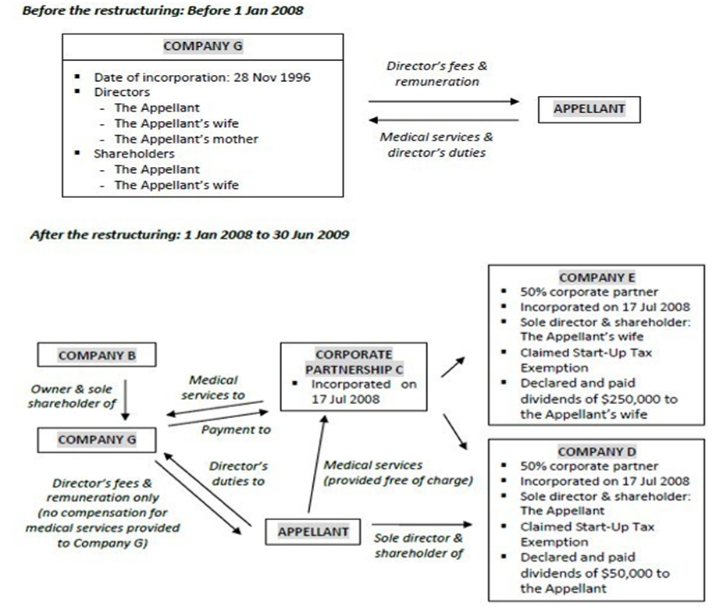
GBF v CIT [2016] SGITBR 1
22
Source : IRAS’ website re Doctor’s restructuring arrangement struck down for tax avoidance
Promoting Tax Excellence
© 2018 Singapore Institute of Accredited Tax Professionals

Slide 24
GBF v CIT [2016] SGITBR 1
Facts of the case
In 1996, the taxpayer, a medical practitioner, together with his wife, incorporated a company (G) to conduct a plastic and cosmetic surgery business. Both the taxpayer and his wife were directors and shareholders of G, and the taxpayer was the sole medical practitioner in G.
In March 2008, pursuant to a share purchase agreement, the taxpayer and his wife sold their shares in G to another company (B). The principal business activities of G remained unchanged. The taxpayer and his wife continued as directors of G and the taxpayer also continued to be employed by G as the sole medical practitioner.
23
Promoting Tax Excellence
© 2018 Singapore Institute of Accredited Tax Professionals

Slide 25
GBF v CIT [2016] SGITBR 1
Facts of the case
In July 2008, the taxpayer formed a corporate partnership (C) with two new corporate partners (D and E). D and E were wholly owned by the taxpayer and his wife respectively.
Under the new arrangement, the “physician compensation” for the taxpayer’s services was paid by G to the corporate partnership C.
24
Promoting Tax Excellence
© 2018 Singapore Institute of Accredited Tax Professionals

Slide 26
GBF v CIT [2016] SGITBR 1
Decision of the ITBR
It was found that there was no change in the modus operandi of G’s practice following the arrangement. C, D and E, had no functional role in G’s practice. There was also no evidence to substantiate the taxpayer’s assertions that the arrangement was set up for the protection of practice and business risks, and for business convenience and benefits to grow the practice.
Hence, it was concluded that there was no genuine commercial reason for the restructuring arrangement. The arrangement was formed solely to receive the taxpayer’s compensation and manage it in the most tax efficient manner.
25
Promoting Tax Excellence
© 2018 Singapore Institute of Accredited Tax Professionals

Slide 27
GBF v CIT [2016] SGITBR 1
Decision of the ITBR
The taxpayer could not rely on the Section 33(3)(b) exception as one of the main subjective purposes of the arrangement was to avoid tax.
The CIT had acted reasonably in disregarding the taxpayer’s restructuring arrangement.
26
Promoting Tax Excellence
© 2018 Singapore Institute of Accredited Tax Professionals

Slide 28
GBF v CIT [2016] SGITBR 1
Comments on the GBF case
The case pertains to a change in business form (corporate vs partnership) in order to obtain a tax advantage.
The arguments in the case focused on whether the taxpayer had bona fide commercial reasons for the arrangement that was entered into.
The Board stated that the taxpayer’s explanation of his business purpose was based solely on oral evidence, which could neither be discerned from documentary evidence nor in his conduct in putting his business plan into action.
The case reiterates that Singapore’s GAAR needs to be taken seriously and must be considered when arrangements are put in place that produce a tax advantage.
27
Promoting Tax Excellence
© 2018 Singapore Institute of Accredited Tax Professionals

Slide 29
Conclusion
The recent tax development as well as the e-tax guide sends a strong signal that general anti-avoidance rule (GAAR) is firmly on the IRAS’ agenda and does not just apply to highly complex financing arrangements such as those in the AQQ case.
With the evolving tax landscape and base erosion and profit shifting (“BEPS”) initiatives, OECD countries and BEPS associates are incorporating anti-abuse rule to combat treaty shopping.
All these further reinforce the stance against abusive arrangements.
28
Promoting Tax Excellence
© 2018 Singapore Institute of Accredited Tax Professionals

Slide 30
Thank You
Mrs Chung-Sim Siew Moon
Board Member
Singapore Institute of Accredited Tax Professionals
Asia-Pacific Tax Policy and Controversy Leader Partner
Ernst & Young Solutions LLP
Office: +65 6309 8807 Email: siew-moon.sim@sg.ey.com
This presentation has been prepared for general guidance and discussion purpose on matters of interest only. It does not constitute professional advice. You should not act upon the information contained in this publication without obtaining specific professional advice and this presentation, in part or in whole, shall not be copied, reproduced or distributed.
Promoting Tax Excellence
© 2018 Singapore Institute of Accredited Tax Professionals

